Slide 1











No Picture Selected

Slide 2
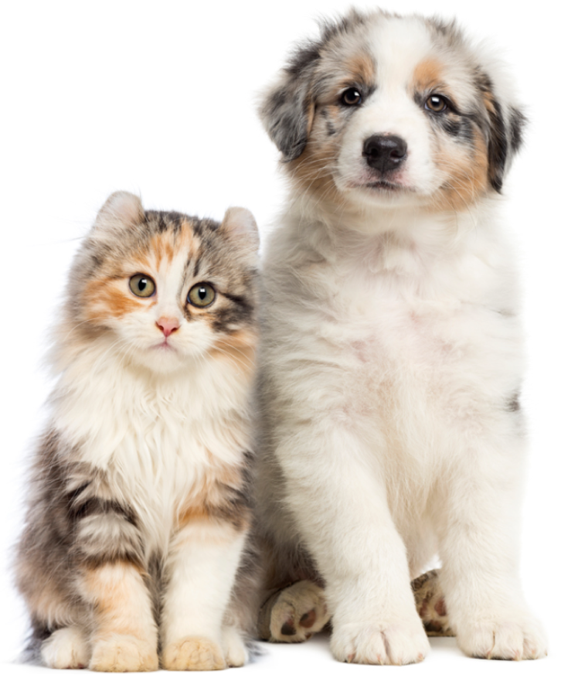

Slide 3



Slide 4
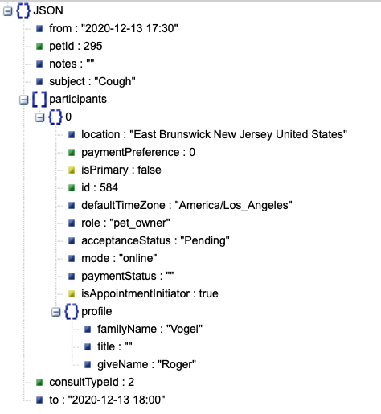
JSON Sent:
Appt Created:

